Slide 1
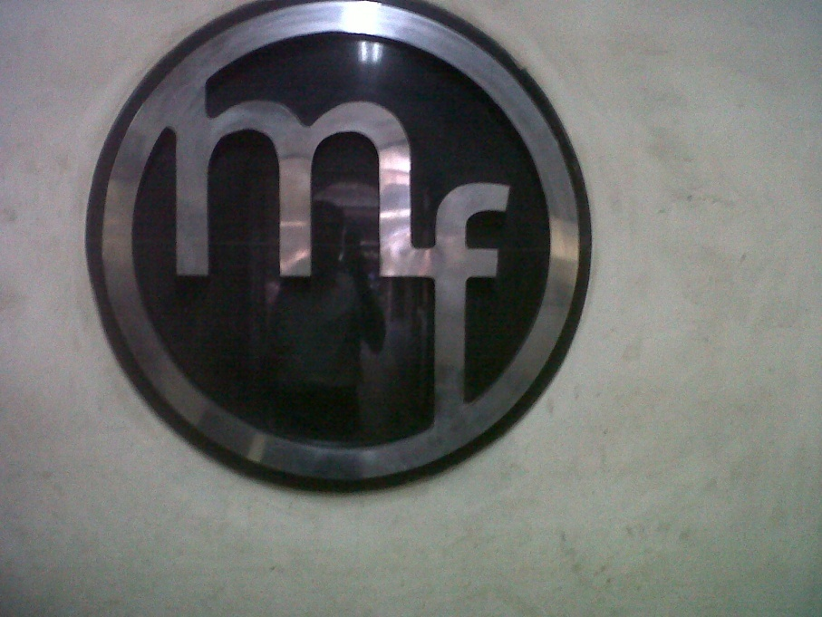
METAL FORGINGS PVT. LTD.
“Like a Magnet, Excellence Attracts the Best of the World”

Slide 2
Index
Organizational Information
Raw Material Storage & Sources
Material of Construction
Manufacturing Facilities
Inspection & Testing Facilities
Products Manufactured by us
Certification, Approvals & Awards
Major Customers
Contact Details
Introduction

Slide 3
Introduction
Metal Forgings Private Limited is one of the largest forging industries in India engaged in manufacturing of light to heavy steel forged components in various grades of carbon, alloy, stainless steel and duplex steel grades. We have been supplying our products since last 53 years to different sectors of industries like Refineries, Petrochemicals, Oil, Gas, Aerospace, Nuclear, Wind, Hydro, Thermal, Power, Defence, Fertilizer, Construction, Automobile, Fabrication and many other Heavy Industry sectors.
We aim at providing industry with internationally accepted high quality products on competitive prices meeting stringent forging standards by virtue of merging latest technology, automation and professional expertise, hence being the pioneer of this trade.
Superior quality, timely delivery & competitive price are the key factors to success for our company.

Slide 4
ORGANIZATIONAL INFORMATION
Incorporated in : 1962
Factory Area : 20,000 Sq. meter
Organization Strength : 300 approx.
Last Turnover : Upon Request
Power Sanctioned : 6000 KW
Connected Load : 4200 KW
Power Backup : 2200 KVA
Installed Capacity : 36000 MT p.a.
New 5 acre facility added in
Ballabhgarh, Faridabad

Slide 5
Products Manufactured by us
Tube Sheets, Disc
Forged Vessel Components
Forged/Rolled Rings
Hollow Forging
Forged Shaft
Customized Forgings
Crankshaft & other Forgings
Pipeline Forged Flanges

Slide 6
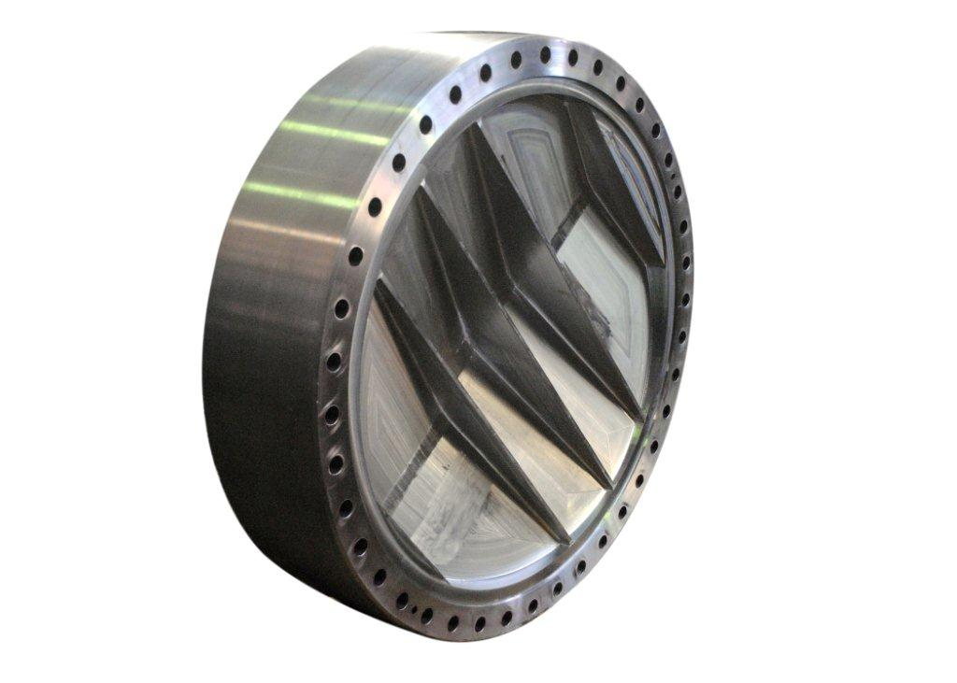
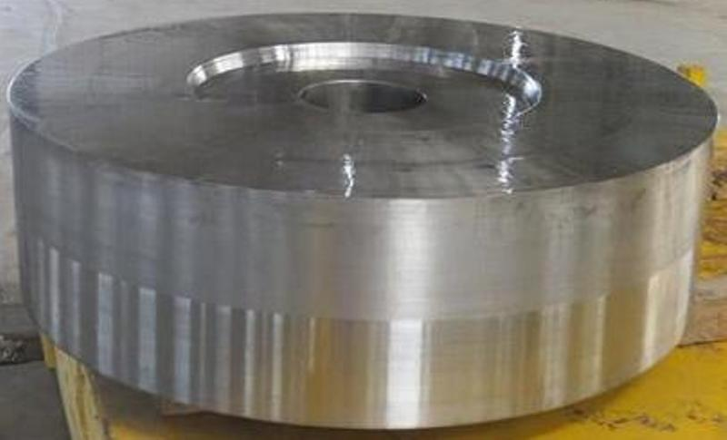
TUBE SHEETS
Max Dia: 2500 mm
Max Thk: 500 mm
Subject to
Max Weight: 10 MT

Slide 7
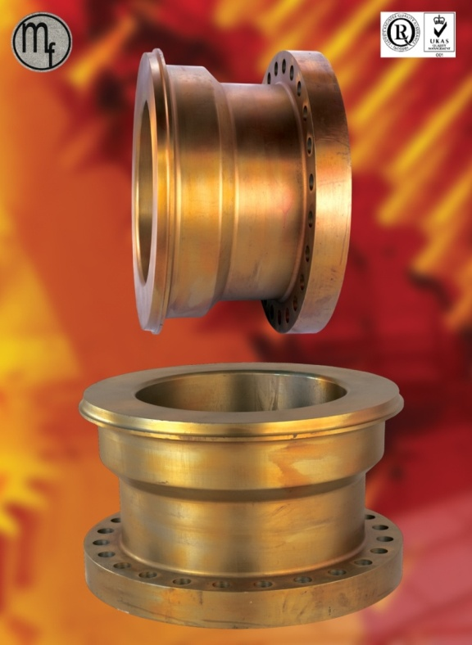
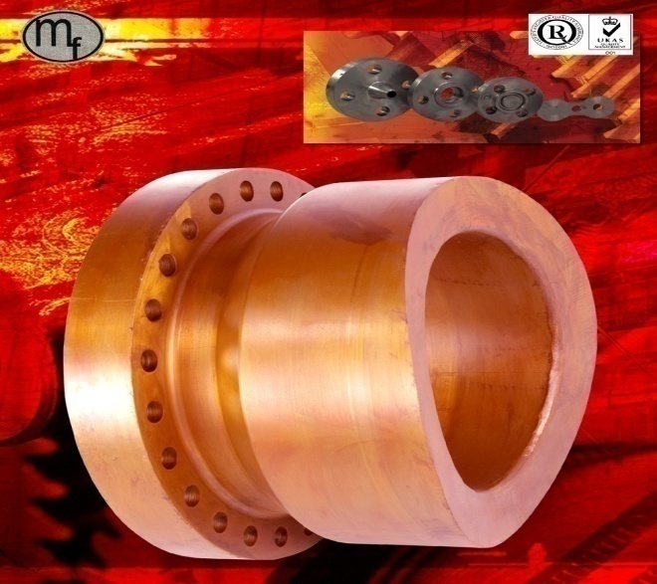
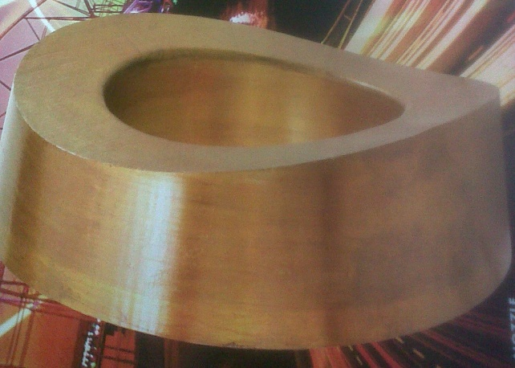
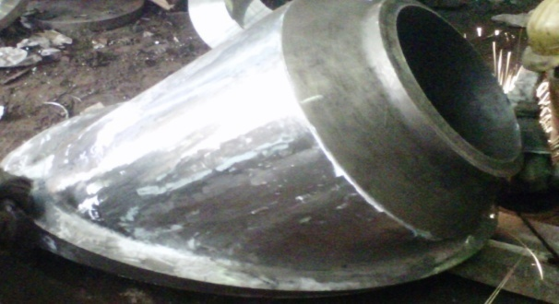
Forged Vessel Components
Max Single Piece
Forged Weight:
12.5 MT
Forged & Finish Machined Nozzles with Cylindrical or Spherical Contours ready to be welded on Vessels.

Slide 8
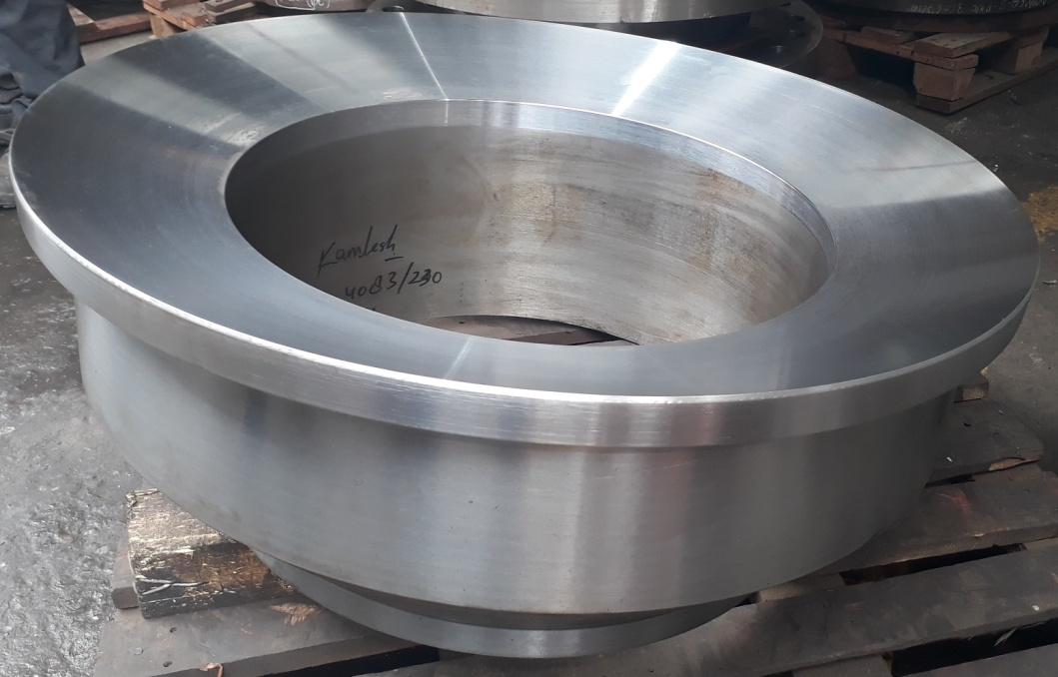
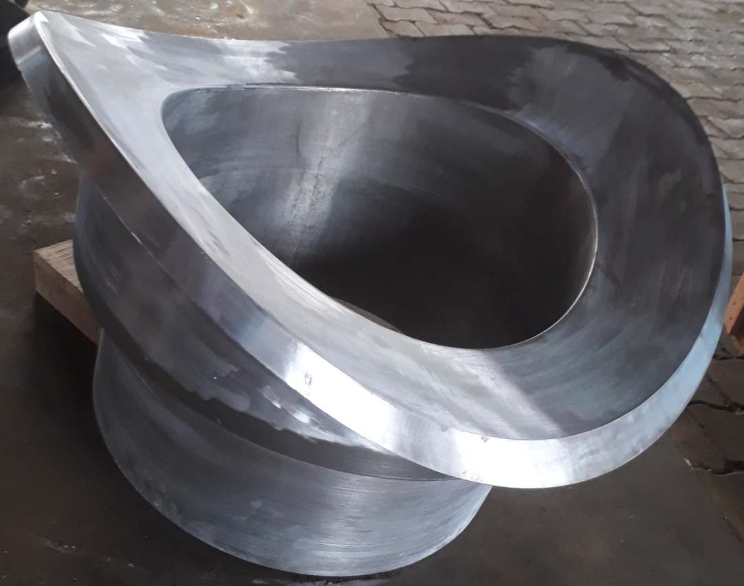
Forged Vessel Components
Nozzles with Cylindrical & Spherical Contours
Notes:
Vennersys Project

Slide 9
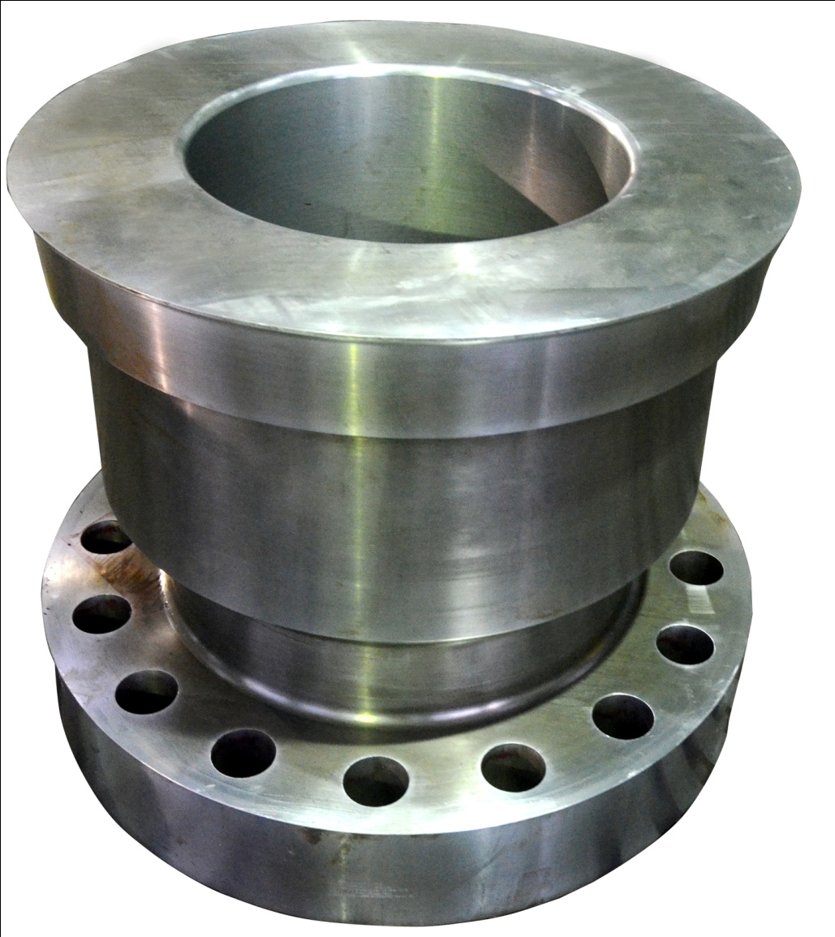
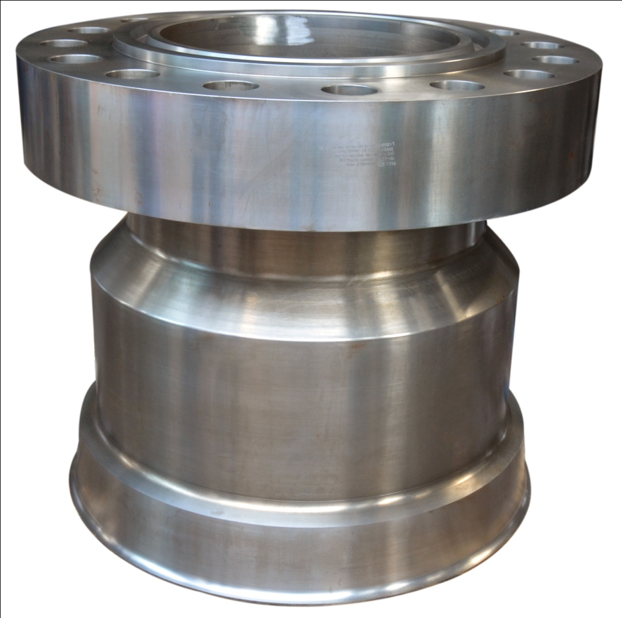
Integral Nozzle Forging
WO: 3516 MOC: SA336 F11 CL-3
Notes:
Vennersys Project

Slide 10
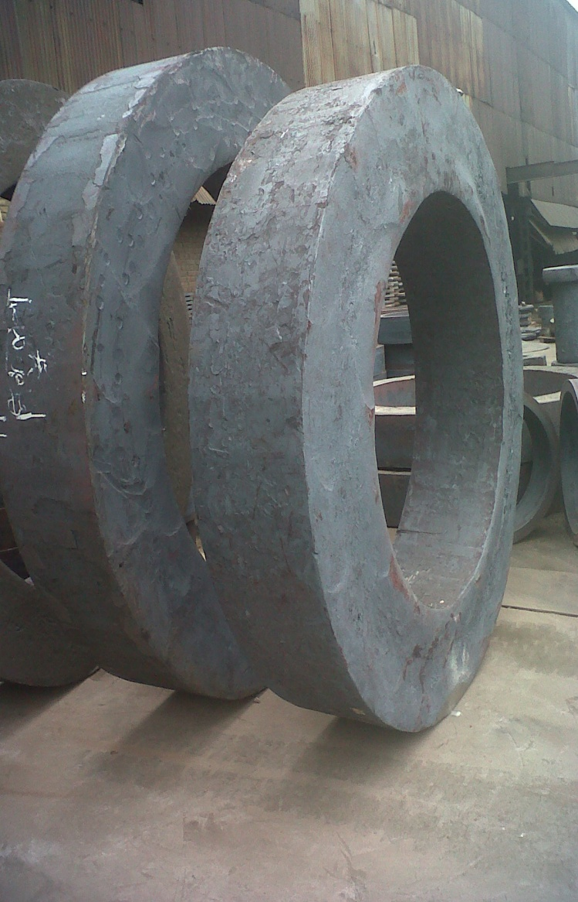
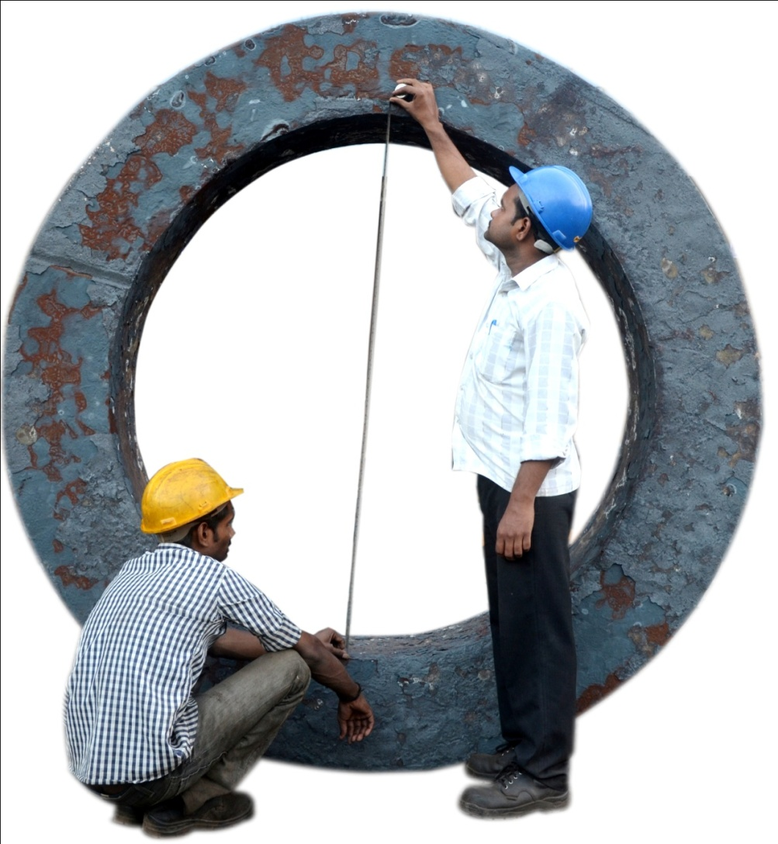
Forged Rings On Open Die Press
Capacity: Max Dia: 2600 mm
Max Weight: 11000 Kg
WO:3784 - SA336 F11 Cl2
Φ2025 x Φ1560 x 393 Thk

Slide 11
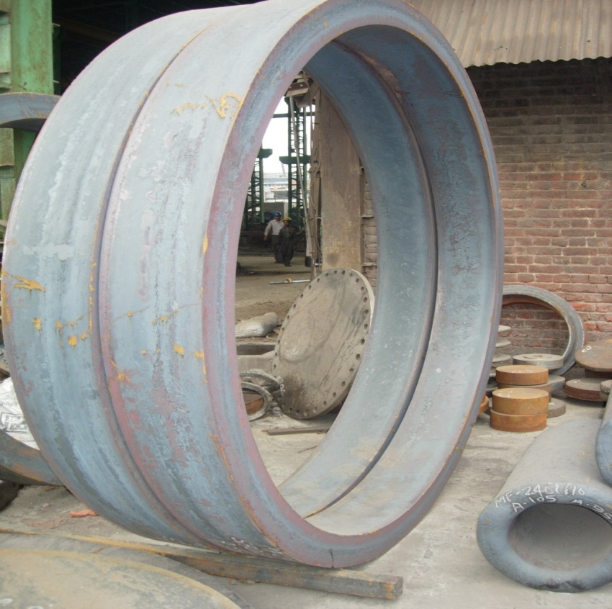
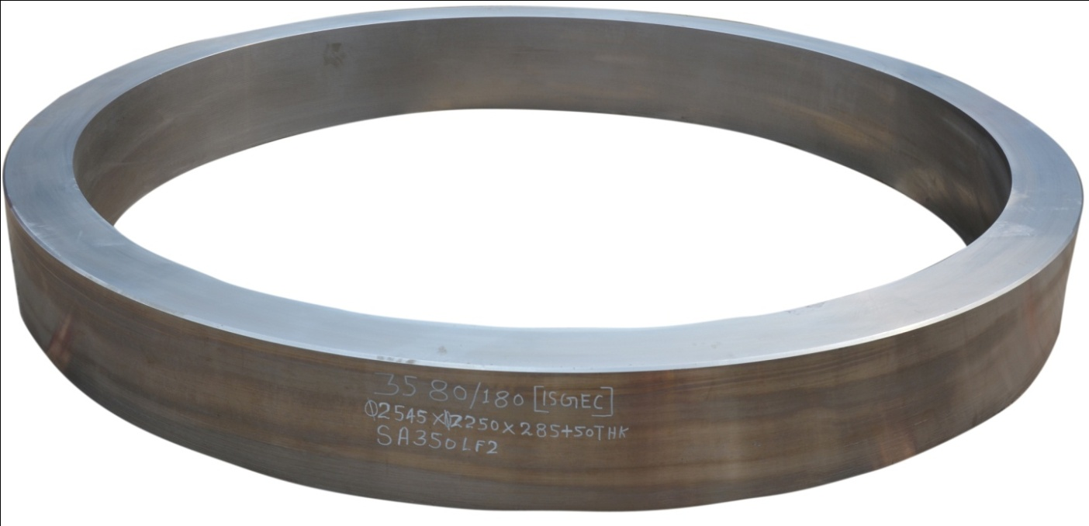
Seamless Rolled Rings
Capacity: Max Dia: 3000 mm
Max Weight: 5000 Kg
Φ2545 x Φ2250 x 335 mm Thk
WO-3580: MOC: SA350 LF2

Slide 12
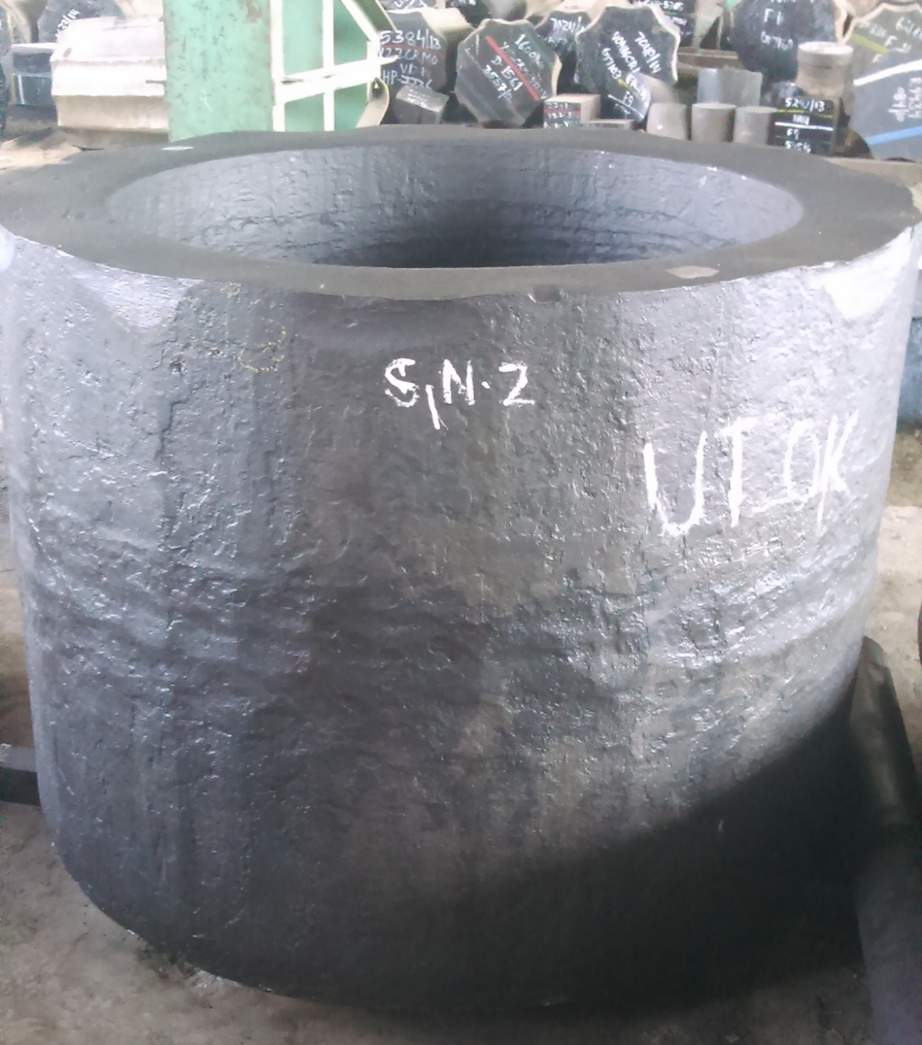
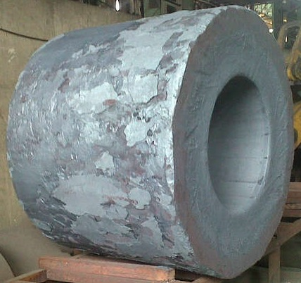
Hollow Shell/Cylinder Forging
Max Dia: 1600 mm Max Length: 2000 mm
Subject to Max. Weight: 12 MT
WO-2502 – SA182 F11 Cl2
Ø1360 X Ø771 X 1004 Long

Slide 13
Forged Proof Machined Shaft
Max Dia: 1000 mm
Max Length: 6500 mm
Max. Weight: 12 MT

Slide 14
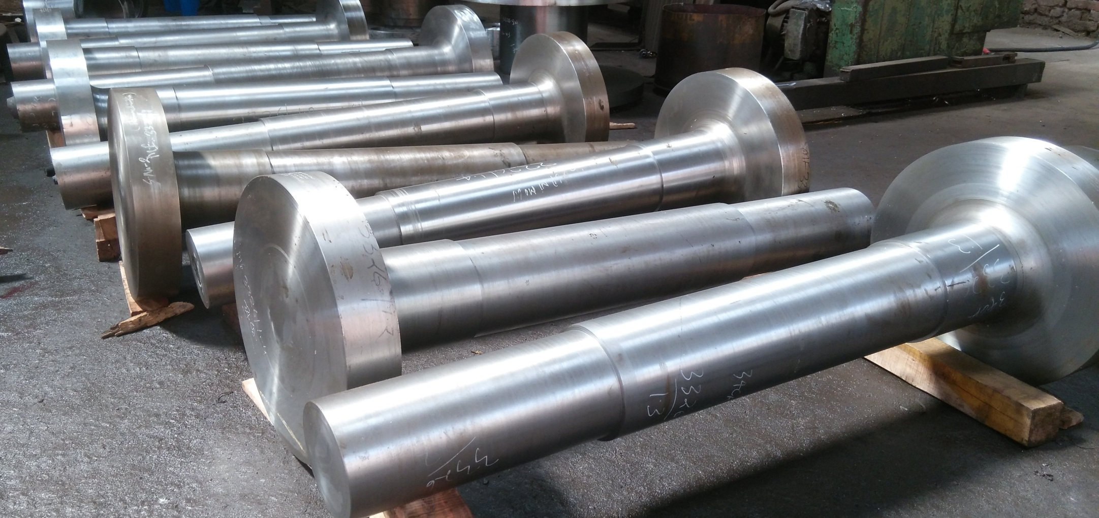
Forged Proof Machined Shaft
Max Dia: 1000 mm
Max Length: 6500 mm
Max. Weight: 12 MT

Slide 15
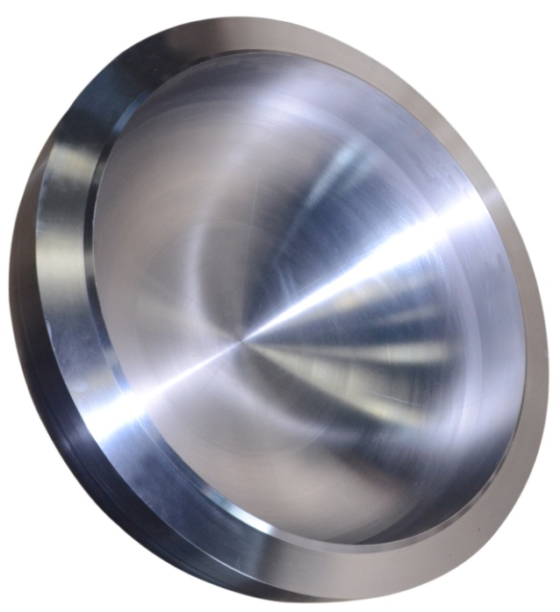
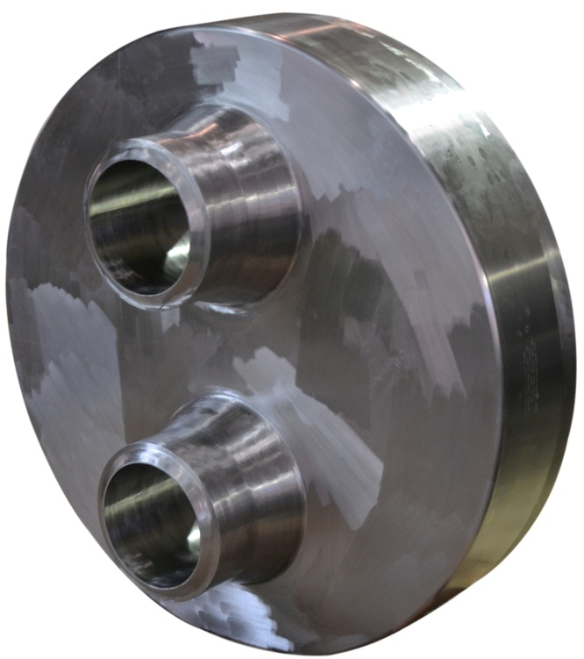
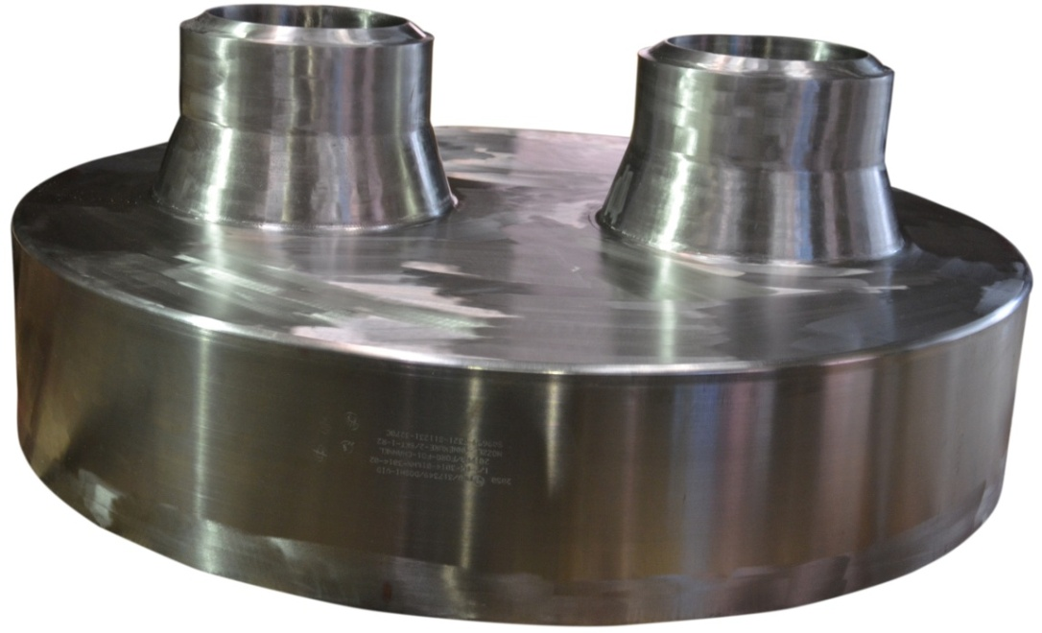
Customized Forged Components
MOC: SA-965 F321
Dish-End :WO-2849
1220Ø X 472.5 Height
Nozzle Cover: WO-2850
Size: 861Ø X 316 THK
Notes:
Vennersys Project

Slide 16
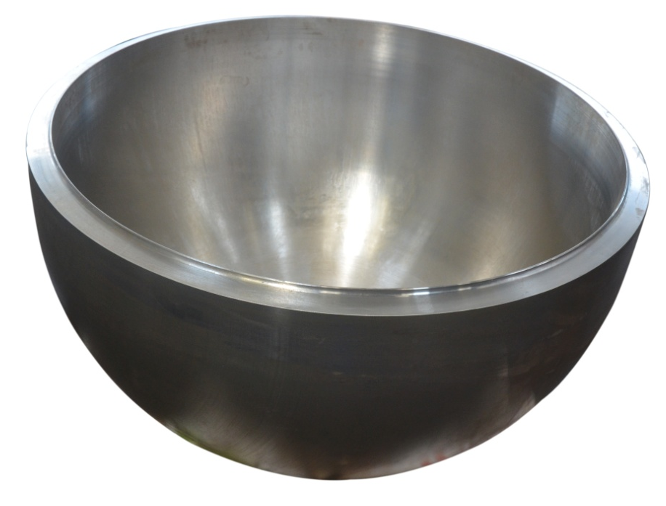
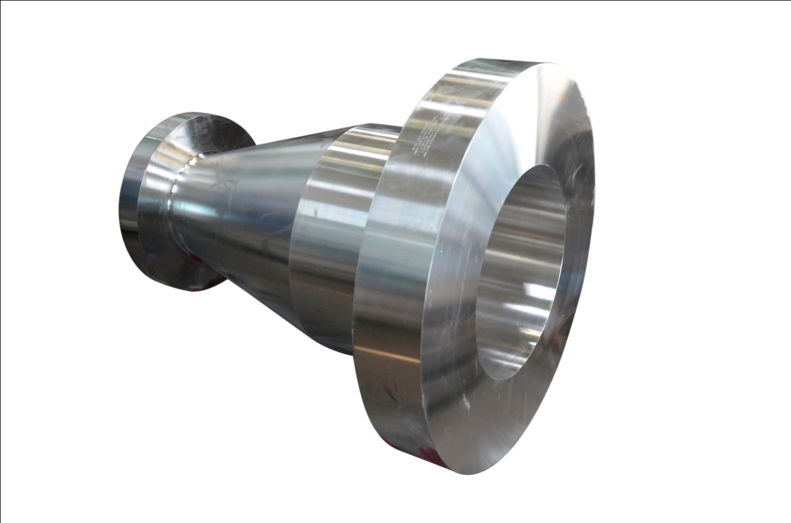
Customized Forged Components
Hemisphere: WO-3596
SA105: Φ1204 x 750 Height
WO: 3516
MOC: SA182 F304L
Notes:
Vennersys Project

Slide 17
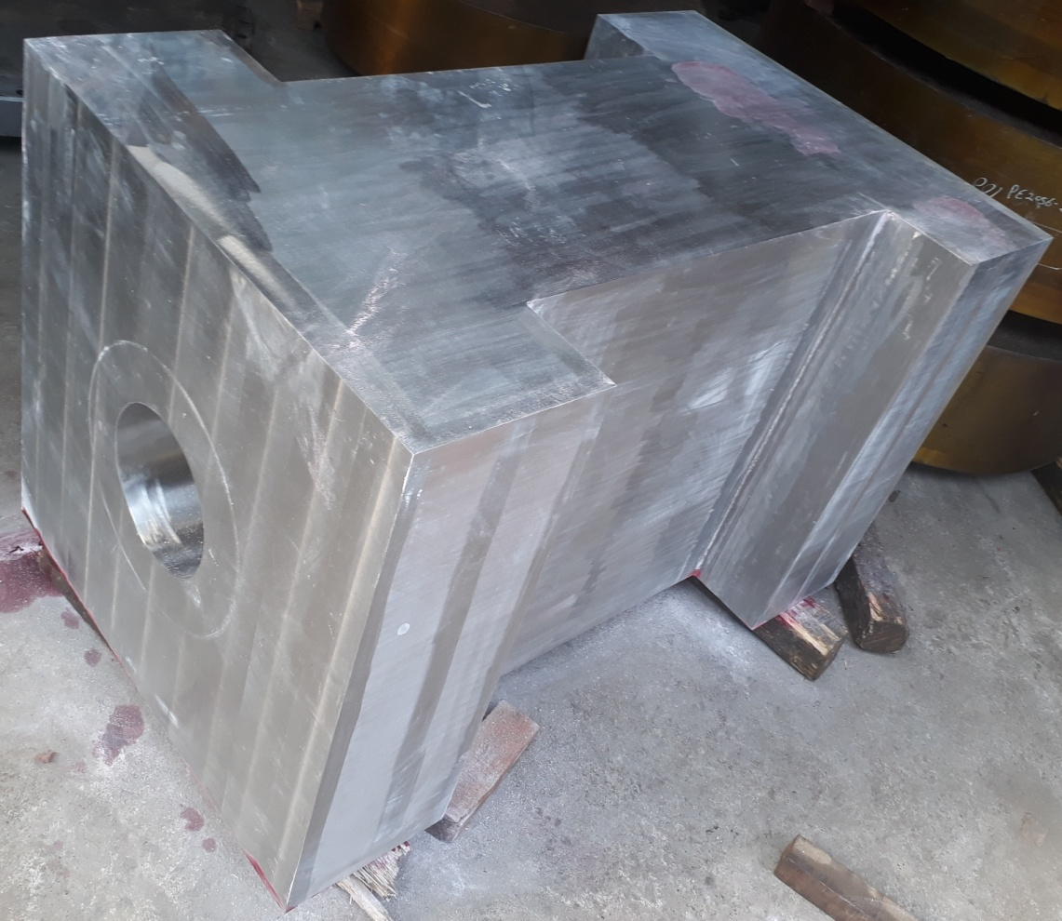
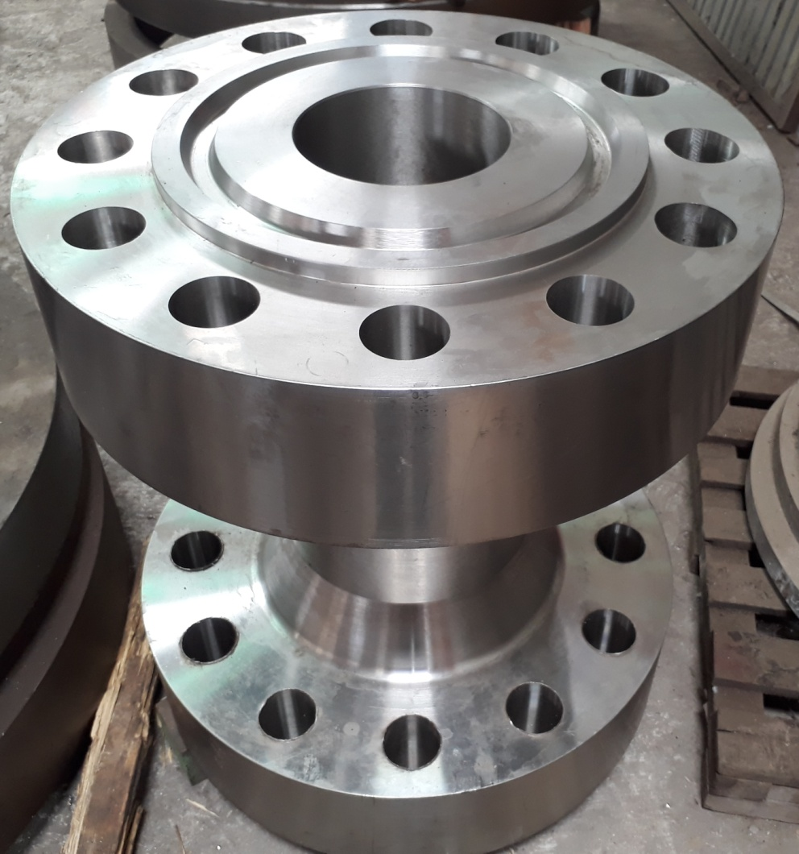
Customized Forged Components
Notes:
Vennersys Project

Slide 18
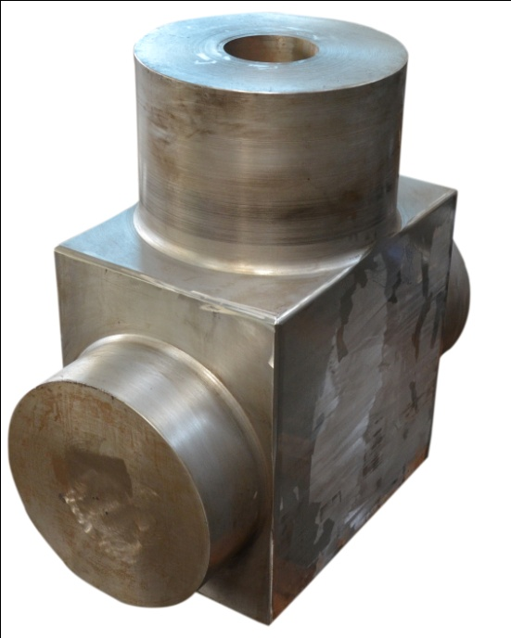
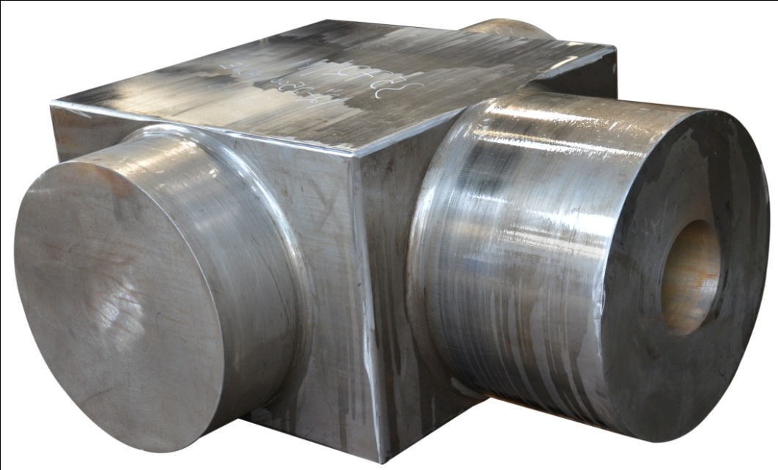
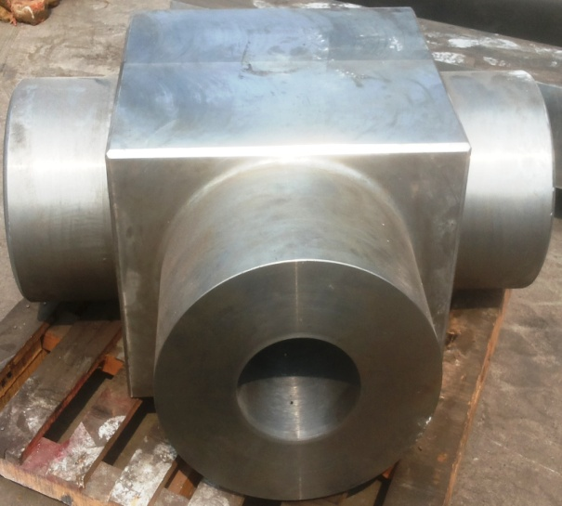
Customized Forged Components
12”-2500-Globe Valve
12”-2500-Check Valve
Notes:
Vennersys Project

Slide 19
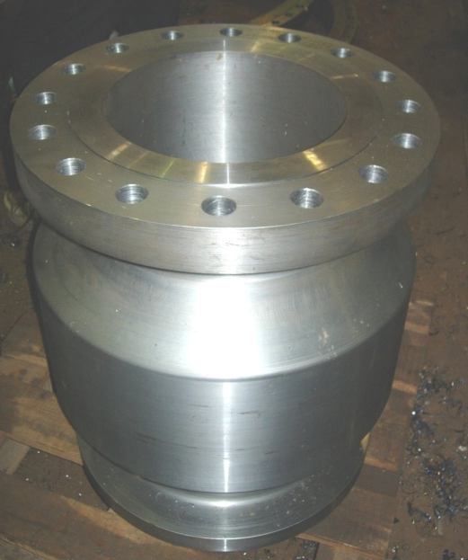
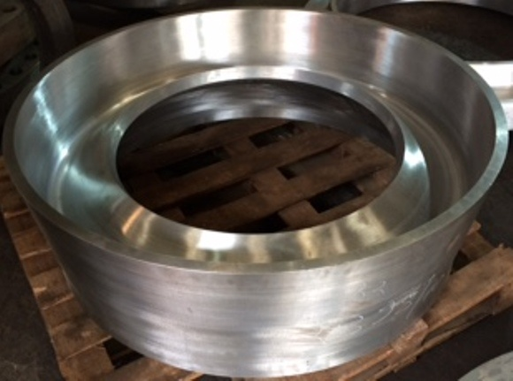
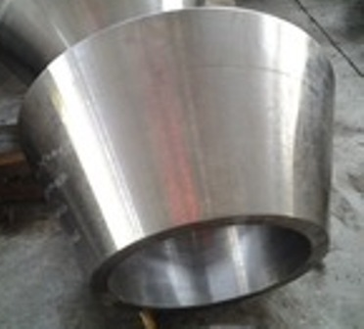
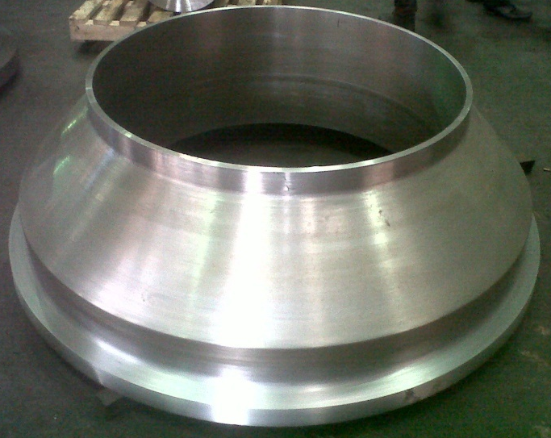
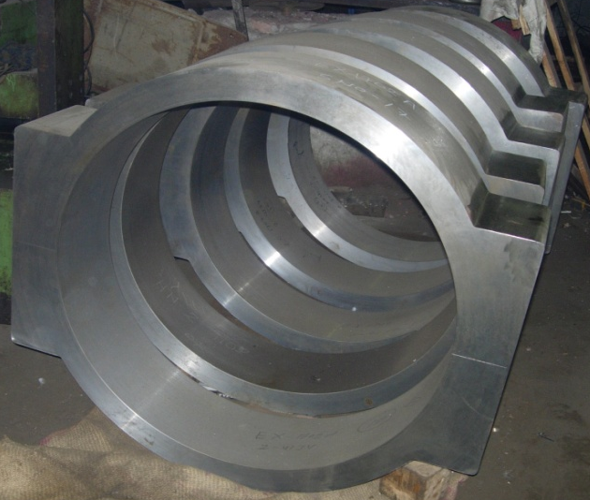
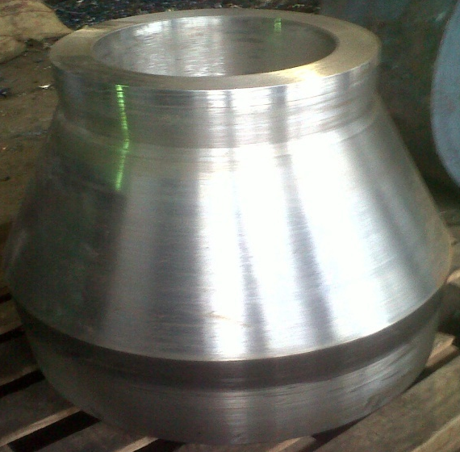
Customized Forged Components
Notes:
Vennersys Project

Slide 20
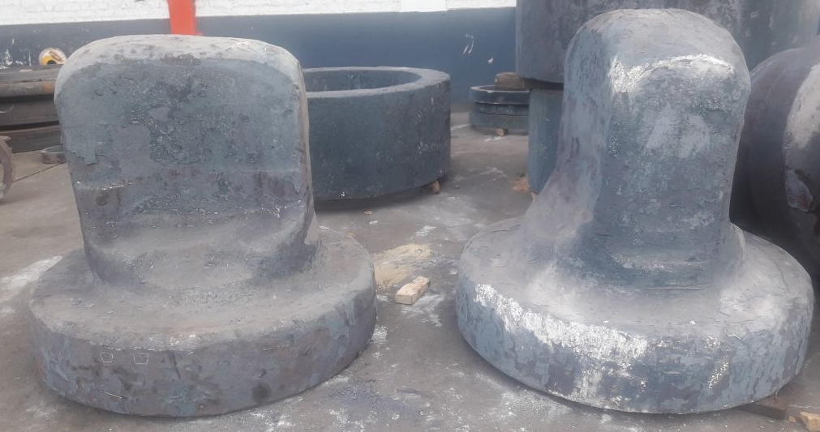
Customized Forged Components (Lifting Covers)
Notes:
Vennersys Project

Slide 21
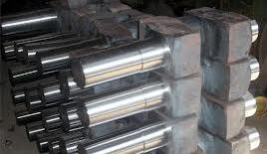
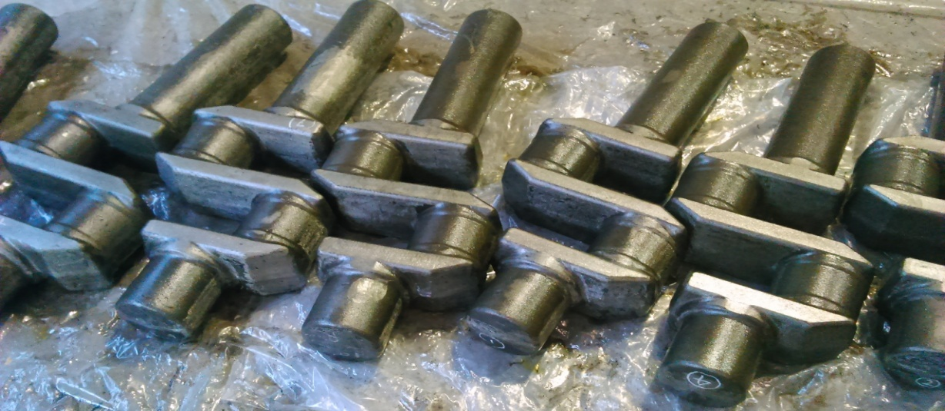
Crankshaft Forgings (OEM for Ingersoll Rand)

Slide 22
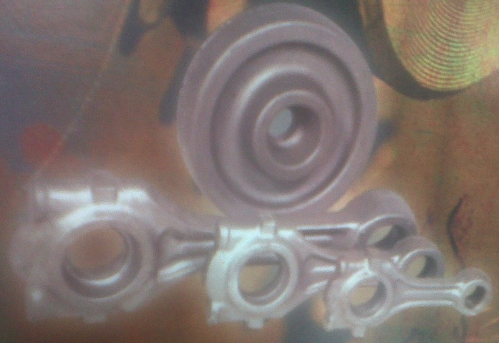
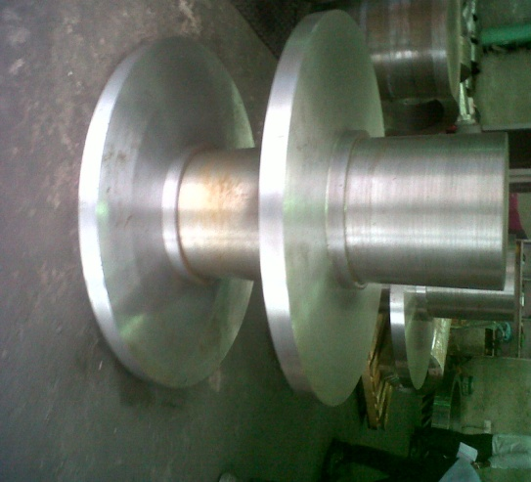
Other Forgings
As per Customer Drawing
Connecting Rods
Gear Blanks, Coupling
Stub End, Reducer etc.

Slide 23
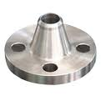
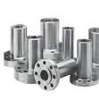
Pipeline Flanges
Size: ½” to 110”
Rating: 150# – 2500#
Dimensions:
ASME, ANSI, AWWA, MSSP, API, IS, BS, DIN, JIS ETC.
B16.5, B16.47, B16.1, B16.48, B16.36 or any other as per drawing / standard.

Slide 24
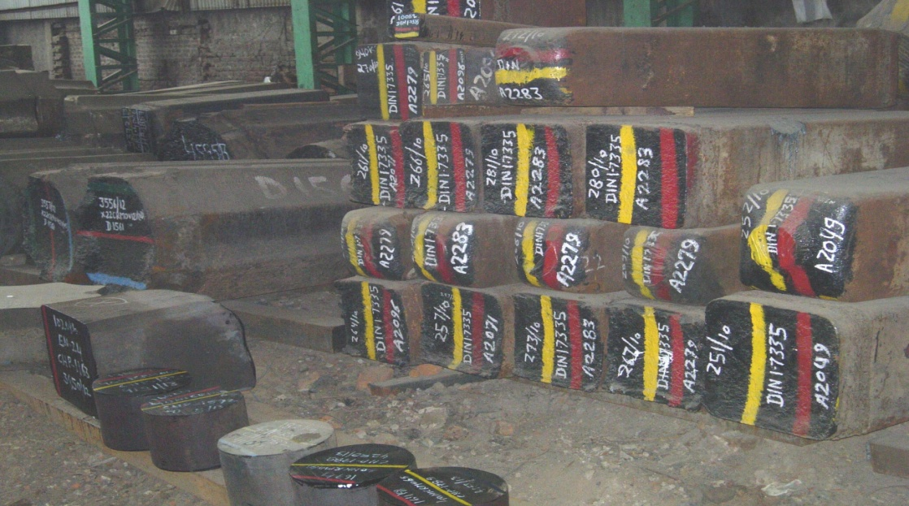
Raw Material
We have fully covered raw material yard equipped with overhead cranes and rail movement system making the loading-unloading of jobs faster & easier.
Each & every raw material is properly color coded and identification mark is placed immediately after receipt & acceptance of material at our plant.

Slide 25
Major Sources of Raw Material - Indigenous
ASP-Durgapur (SAIL)
Remi Metals Gujarat Ltd.
Jindal Steel & Power Ltd.
Ambica Steels Ltd.
Star Wire India Ltd.
Laxcon Steels Ltd.
Usha Martin
Arcvac
Goradia Special Steels
RINL Vizag
MUSCO
Kalyani
L&T Special Metals
Contd…

Slide 26
Major Sources of Raw Material - Overseas
Acciaierie Bertoli Safau SpA (ABS)
Acciaierie Venete SpA
Outokumpu
NLMK Verona
PCK BUDERUS

Slide 27
Material of Construction (MOC)
Regular Carbon Steel Grades
SA 105, SA 181, SA 508 | S355J2G3, S235JR
SA 266 Gr.2, Gr.3, Gr.4 | EN 8, EN 9
SA 350 LF1, LF2, LF3 | 20C8, 30C8, 40C8, 45C8
SA 765 Gr.II, Gr.IV
A694 F52, F60, F65, F70
Any other as per ASTM, ASME, EN, DIN, BS, IS, AISI/SAE grades as specified by customer.

Slide 28
Material Of Construction (MOC)
Regular SS & Duplex Steel Grades
SA182/SA965 F304/304L/304H, F316/316L/316H/316Ti
SA182/SA965 F317/317L, F321/F321H, F347/347H
SA182 F51, F52, F53, F60 (Duplex Grades)
SA182 F6a
SS410, SS420
Any other as per ASTM, ASME, EN, DIN, BS, IS, AISI/SAE grades as specified by customer.

Slide 29
Material Of Construction (MOC)
Regular Alloy Steel Grades
SA182/SA336 F1, F5, F9, F11, F12, F22, F91
21CrMoV57, X22CrMoV12-1, 40NiCrMo65, 16MnCr5 30CrNiMo8, 31CrMoV9, 18CrNiMo6-7
EN19/42CrMo4, EN24 / 34CrNiMo6, EN25, EN31, EN353, 4140, 8620, SAE52100
Any other as per ASTM, ASME, EN, DIN, BS, IS, AISI/SAE grades as specified by customer.

Slide 30
Manufacturing Facilities
RM Cutting
Heat Treatment
Final Machining/ Drilling
Forging
Rough Machining
Packing &
Dispatch
Great work happens in great environment.

Slide 31
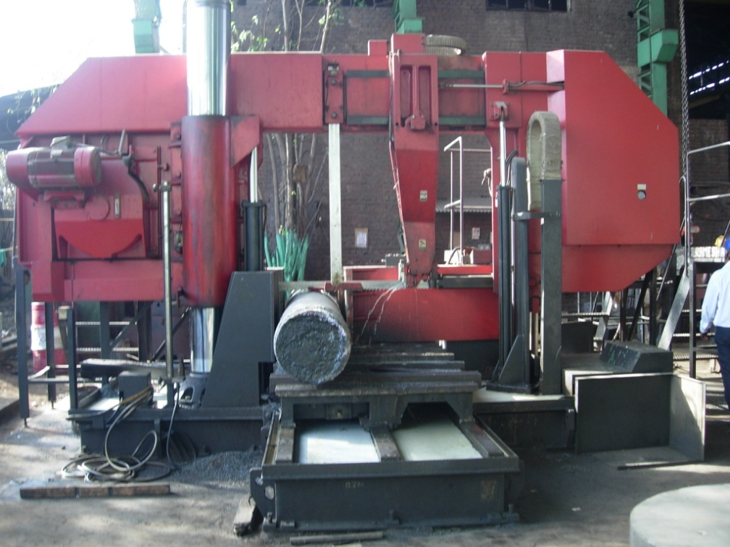
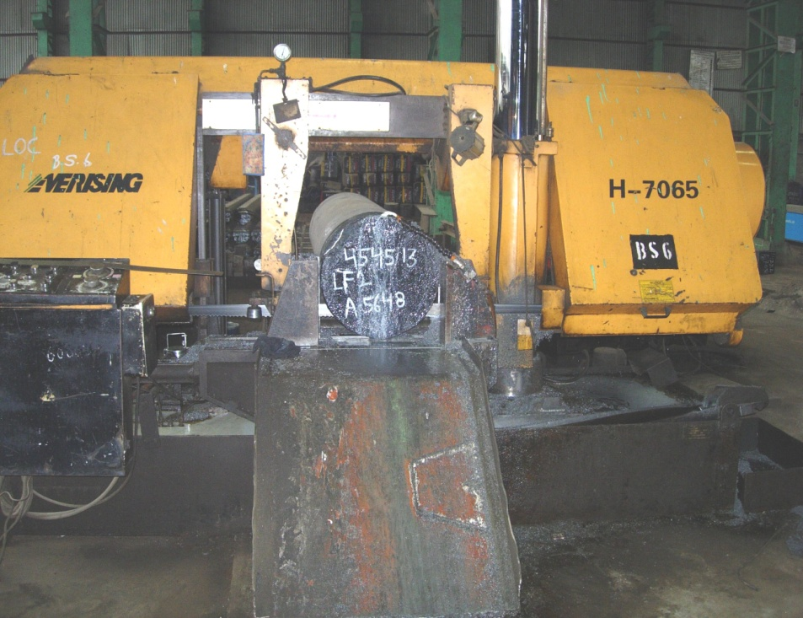
CNC Cutting Machines
Horizontal Band saw Amada / Frigi
(400mm – 1400mm)
Qty – 09 Nos. (MP-DEL)
Qty – 07 Nos. (BG-FBD)
Max Cutting Size
Ø1400 mm
Notes:
New PLC Controlled Bandsaws (AMADA 1300 II)

Slide 32
Forging Facilities
Open Die / Free
Forgings
Seamless
Rolled Ring
Forgings
Close Die /
Impression Die
Forgings
“Forging is the term for shaping metal by plastic deformation”

Slide 33
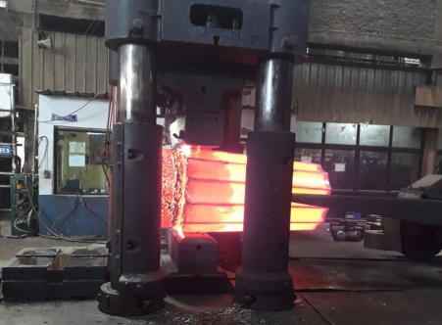
Open Forging Press
2500 Ton Open Forging
Hydraulic Press
15 Ton Electric Manipulator
Siemens S7 PLC integrated
Maximum Single Piece Forging capacity
15 Ton

Slide 34
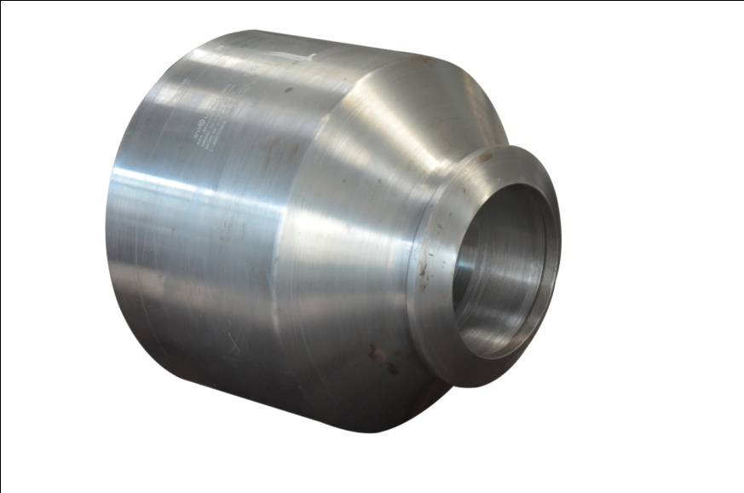
Open Forging Hammers
Open Forgings Hammer - 1 No. (MP-DEL)
Open Forgings Hammer - 2 Nos. (BG-FBD)
Electro Hydraulic Hammer - 1 No. (BG-FBD)
MPM Hammer – 1 No. (BG-FBD)
Forging Press Hydraulic- 1000 Ton (BG-FBD)
Trimming Press – 1000 Ton (BG-FBD)

Slide 35
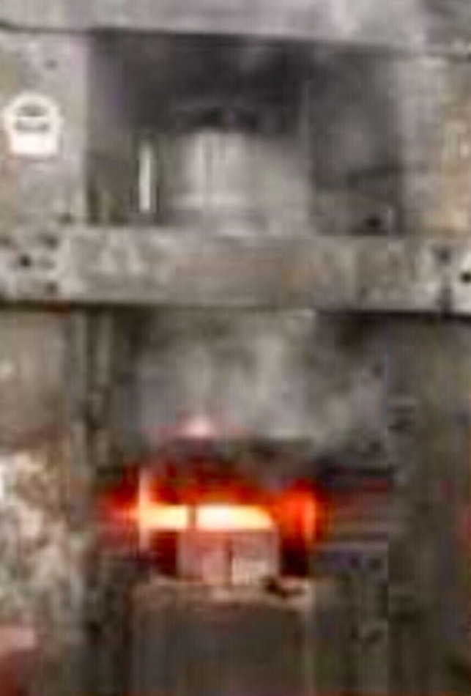
Close Die Forging Lines
40 MT Counter Blow Close Die Hammer (BG-FBD)
13 MT Counter blow Close Die Hammer (MP-DEL)
25 MT Counter Blow Close Die Hammer (BG-FBD)
MP-DEL:
1 MT Drop Hammer
1600 Ton Forging Press
1250C Frame Hammer
Trimming Press – 150 Ton
Trimming Press – 250 Ton
Trimming Press – 630 Ton
Notes:
* Under Installation

Slide 36
Seamless Rolled Ring Forging
Ring Roller(MP-DEL):
(with 5 Ton Manipulator)
Max. OD – 2900 mm
Max. Thk – 520 mm
Ring Roller(BG-FBD):
Max. OD – 1100 mm
Max. Thk – 225 mm
Manipulator – 1.5 & 2.5 Ton

Slide 37
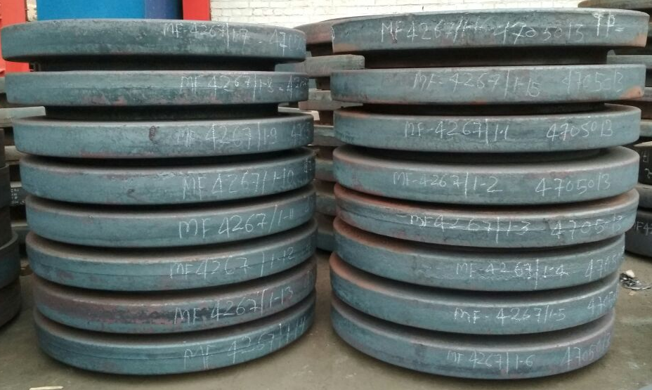
Seamless Rolled Ring Forging

Slide 38
Heat Treatment Facility
Details of Furnace | Capacity | Treatment
Heat Treatment Furnace (Calibrated as per AMS-2750E/API6A) Size: 6000 x 2800 x 1700 mm | 20 Ton | Annealing, Normalizing, Hardening, Tempering
Heat Treatment Furnace (Calibrated as per API6A) (5000 x 2500 x 2200 mm) | 20 Ton | A, N, H, T
Heat Treatment Furnace (Calibrated as per API6A) (2500 x 2000 x 1200 mm) | 10 Ton | A, N, T
Water Tank Size: L 6000 x W 4000 x Deep 6000 mm with Vertical Quenching Facility. | - | Solution Annealing, Quenching
POLYMER Quenching Tank Size: L 3000 x W 3000 x Depth 5000 mm with Vertical Quenching Facility | - | Polymer Quenching
Laboratory Muffle Furnace (6” x 6” x 15”) – 2 Nos. | - | Simulation Heat Treatment
Laboratory Muffle Furnaces(12” x 12” x 15”) – 1 Nos. | - | Simulation Heat Treatment & Step Cooling Test

Slide 39
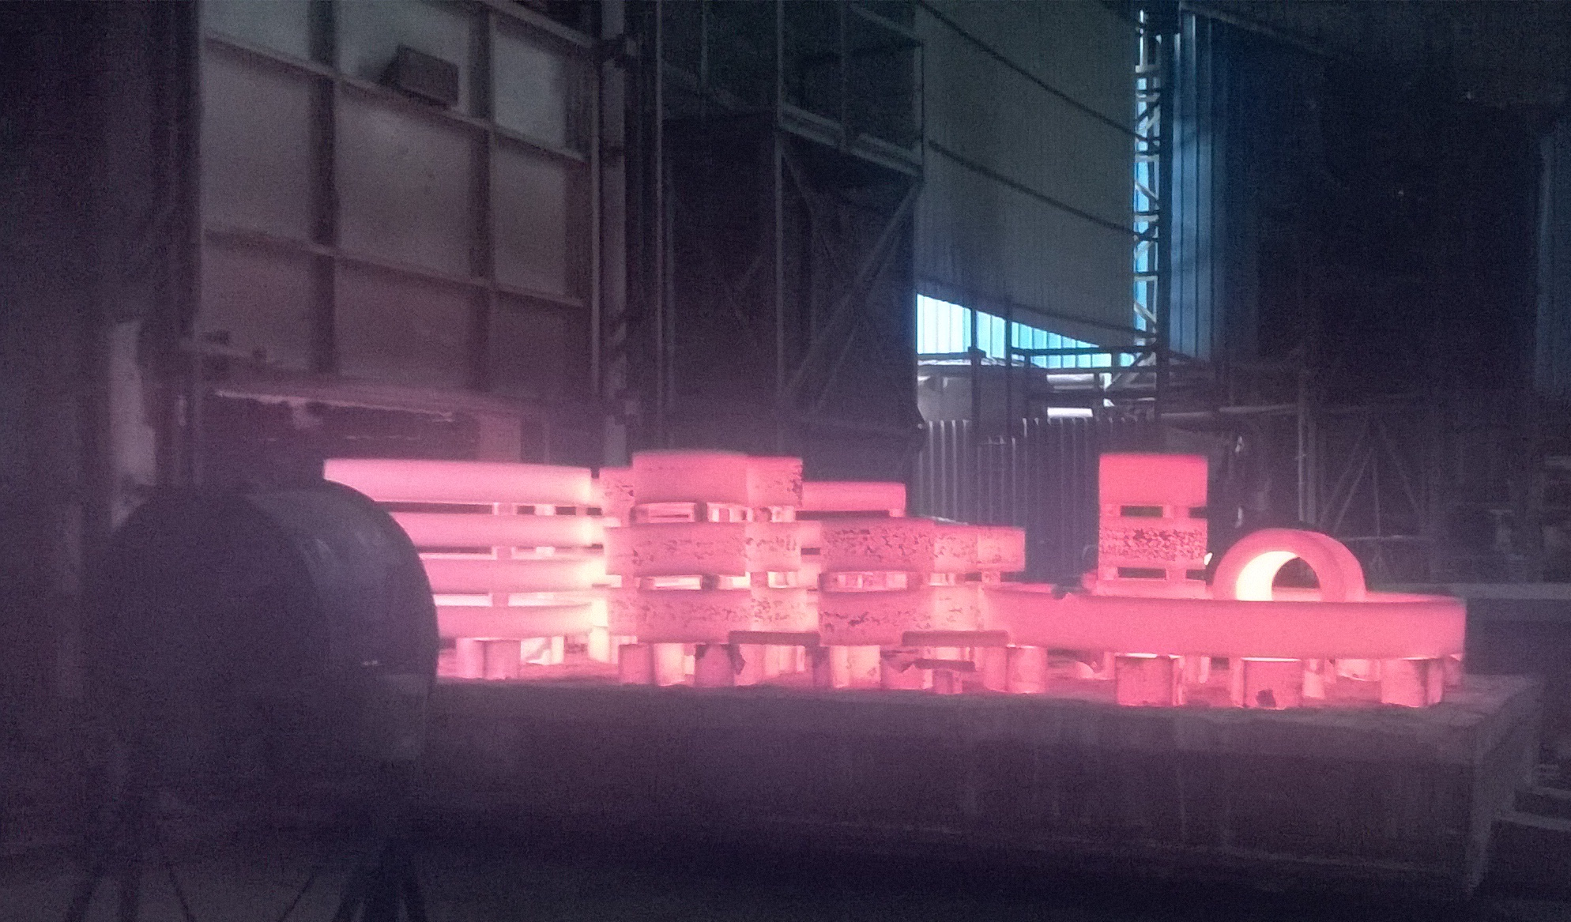
Heat Treatment Facility

Slide 40
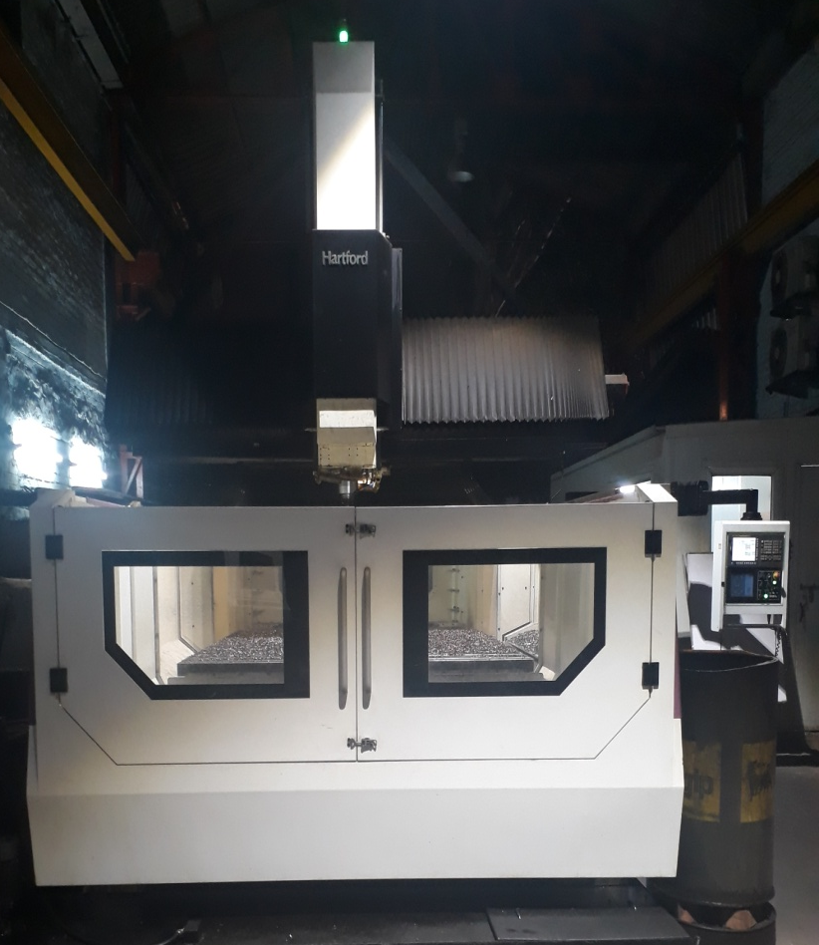
Machining & Handling Facilities (MP-DEL)
Type of Machines | Number of Machines
Horizontal Lathe | 29
Milling & Planner Machine | 02
VTL | 12
CNC VTL | 3
CNC | 5
VMC | 4
Drill Machine | 21
HMC | 1
Double Column Machining Centre | 1
Fork Lift | 07
Hydra Mobile Crane | 01
Cranes-5/10/20 MT | 23
Notes:
WO# 1655 : Tube Sheet. Forge weight 7.2mt

Slide 41
Machining & Handling Facilities (BG-FBD)
Type of Machines | Number of Machines
Horizontal Lathes | 04
Planning Turning M/c | 01
VTLs | 04
Drill Machines | 03
Shaper M/c | 02
Hydra Mobile Crane | 01
ForkLifts | 06
Cranes-5/10/20 MT | 03
Notes:
WO# 1655 : Tube Sheet. Forge weight 7.2mt

Slide 42
Chemical & Metallurgical
Emission Spectrometer 17 Channel
Metallurgical Microscope – 1000X
Travelling Microscope
Metallography Equipment

Slide 43
Mechanical Testing
We have in-house :
Universal Testing M/c 200 KN Make GDR
Impact Test up to -196⁰ C
Hardness Test
Bend Test
Macro Etch Test

Slide 44
Non-destructive Testing
We have in-house:
Ultrasonic Testing Machines
Dye Penetrate Testing
Liquid Penetrate Testing
Magnetic Particle Bench & Yoke type
PMI Testing Machines
Ferrite Meter
Coat meter
Equotip Hardness tester
Brinell Rockwell Hardnes tester
Jominy Hardenability tester
Laser Digital Pyrometer
Radioactive Tester

Slide 45
Third Party Inspection Agencies
Engineers India Ltd. (EIL)
Certification Engineers International Ltd. (CEIL)
Lloyds Register Asia (LRA)
Det Norske Veritas (DNV)
TUV (Nord), TUV (Sud), TUV Rheinland
Bureau Veritas Industrial Services (BVIS)
Tata Projects Ltd (TPL)
Bax Council
Projects & Development India Ltd (PDIL)
IBR
and many more…

Slide 46
CERTIFICATIONS
ISO 9001 : 2008 BY LRQA
ISO 14001 : 2004 BY KFQ
ISO 18001 : 2007 BY KFQ
PED / AD 2000 Merkblatt W0 BY TUV
IBR - Well Known Forge
Engineers India Limited (EIL)
Project & Development India Ltd (PDIL)

Slide 47
CERTIFICATIONS
ISO 9001:2008
PED/AD 2000 W0
PED/AD 2000 W0

Slide 48
CERTIFICATIONS

Slide 49
CLIENT APPROVALS
Oil, Gas & Petrochemical
GAIL, IOCL, BPCL, MRPL, ONGC, Exxon/Mobil etc.
Bharat Heavy Electricals Ltd.
BHELs–Hyderabad, Chennai, Trichy,
Bhopal, Haridwar, Varanasi, Ranipet
Larsen & Toubro Ltd
ISGEC Hitachi Zosen Ltd.
ISGEC Heavy Engineering Ltd.
Reliance Industries Ltd.
Triveni Turbines
Godrej & Boyce Mfg Co Ltd
Ordnance Factory (EF, HVF) Awadi
Ordnance Factory, Ambajhari
L&T Mitsubishi Hitachi Power Systems
NTPC
BEML Ltd.
Toshiba
Siemens Ltd
DLW Varanasi-Railways
GE Power
ZF
SKF
ABC Bearigns
Lyondell Basell USA
Linde Engineering

Slide 50
OUR CLIENTELE

Slide 51
Client Approvals (Defence Ordnance Factories)

Slide 52
Thank you
for sparing your valuable time
Our New Website “Coming Very Soon” at
www.metalforgings.com
Contact
Metal Forgings Pvt. Ltd.
B-1, Mayapuri Industrial Area, Phase-I, New Delhi, India – 110064
Ph: +91-11-40777333, Fax: +91-11-41833107
Email: sales@metalforgings.com
URL: http://www.metalforgings.co.in (www.metalforgings.com coming soon)

